Slide 1
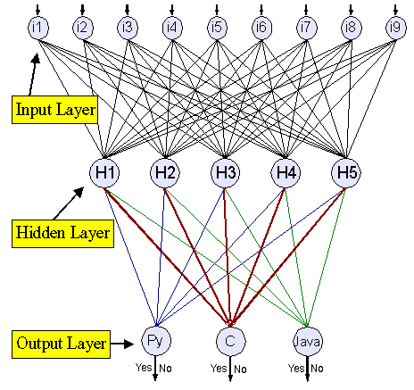
AI Current Development,
Neural Networks and Deep Learning
Ioannis Tsioulis (MC)
Module 6CM521: Frontiers in AI and Data Science
Slides acknowledgements: Dr Hong Qing Yu

Slide 2
Outline
AI recent development
ANN
Deep Learning

Slide 3
AI Recent Development (1)
Deep Learning:
Deep learning is a subset of AI that uses artificial neural networks to simulate the learning process of the human brain.
Deep learning has been used to develop models for image and speech recognition, natural language processing, and other applications.
Some of the most significant recent developments in deep learning include the development of convolutional neural networks (CNNs) for image recognition and recurrent neural networks (RNNs) for natural language processing.

Slide 4
AI Recent Development (2)
Combining with Reinforcement Learning:
Reinforcement learning is a type of AI that focuses on training agents to make decisions in an environment in order to maximize a reward signal.
Reinforcement learning has been used to develop models for game playing, robotics, and other applications where agents need to make decisions in complex environments.
Some of the most significant recent developments in reinforcement learning include the development of deep reinforcement learning algorithms, such as the Deep Q-Network (DQN), which uses deep neural networks to estimate Q-values for state-action pairs.

Slide 5
AI Recent Development (3)
Generative Language Models:
Generative language models are a type of AI model that can generate human-like responses to natural language prompts.
The first generative language models were based on statistical methods, but they were limited in their ability to produce coherent and meaningful responses.
In recent years, deep learning has been used to develop more advanced generative language models, such as OpenAI's GPT (Generative Pre-trained Transformer) series.

Slide 6
AI Recent Development (4)
The Transformer:
A type of neural network architecture that can be used for a variety of machine learning applications, including natural language processing (NLP), computer vision, and speech recognition
Processes entire sequences of data in parallel, making it more computationally efficient than traditional sequential models
Uses self-attention mechanisms to focus on different parts of the input sequence depending on the context, improving performance on a variety of tasks

Slide 7
AI Recent Development (5)
ChatGPT4:
ChatGPT4 is the latest version of OpenAI's generative language model that uses deep learning to generate human-like responses to natural language prompts.
ChatGPT4 is based on the transformer architecture, which allows it to process large amounts of text and generate responses that are both coherent and contextually appropriate.
ChatGPT4 has over 10 trillion parameters, making it one of the largest language models in existence.

Slide 8
AI Recent Development (6)
Multi-modality Models:
A type of AI model that can process and integrate information from multiple sources, such as text, images, and audio
Designed to handle complex data that is represented in multiple modalities
Use deep learning techniques such as CNNs and RNNs to extract features from each modality, which are then combined and processed by the model
Driven by the increasing availability of data that includes multiple modalities and the need for AI systems to process complex real-world scenarios
Applications include speech recognition, image captioning, and natural language processing

Slide 9
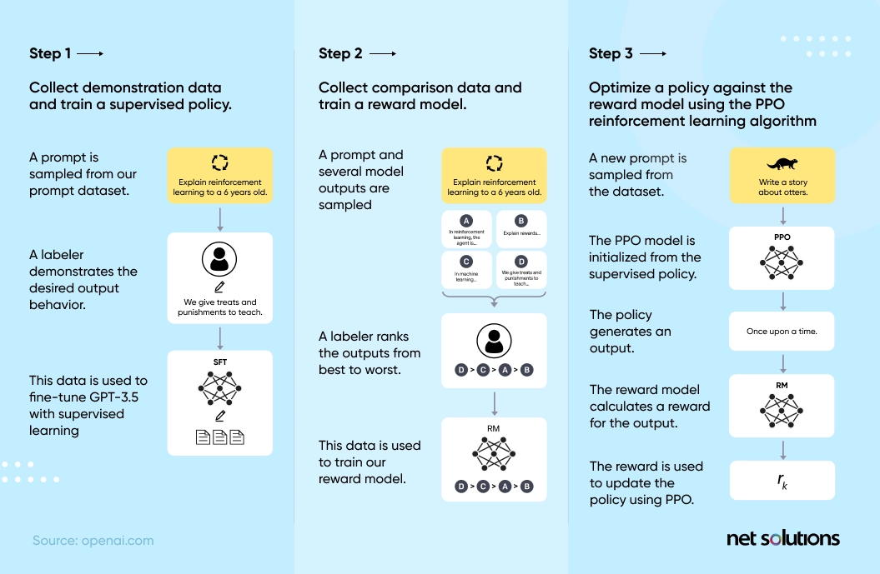
ChatGPT development framework

Slide 10
Trend
Design and implement Algorithm
Select and Fine-Tuning models
Prompt Engineering

Slide 11
ANN History
ANN isn’t a new idea, it has been introduced far back to1943 by Warren McCulloch and Walter Pitts’ research paper “A Logical Calculus of the Ideas Immanent in Nervous Activity”. The paper describes a networks of artificial neurons model that can solve some logic problems.
In 1969, when a formal self-justification mathematic algorithm called backpropagation is introduced, then ANN is widely known and used.

Slide 12
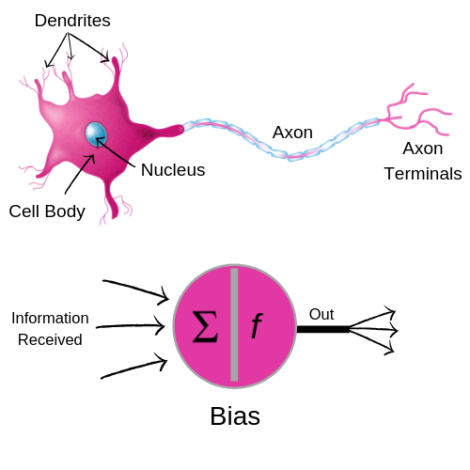
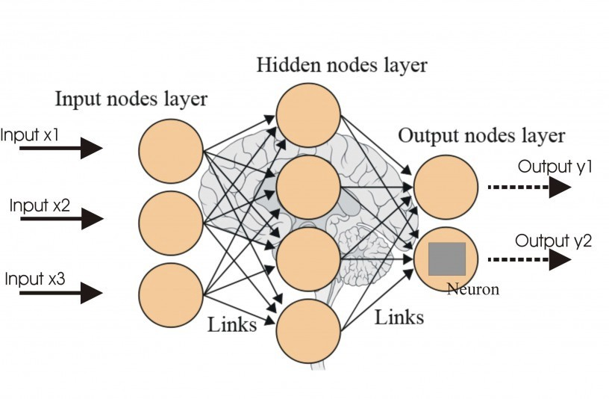
Motivations of ANN
Take inspiration from human brain
←backpropagation

Slide 13
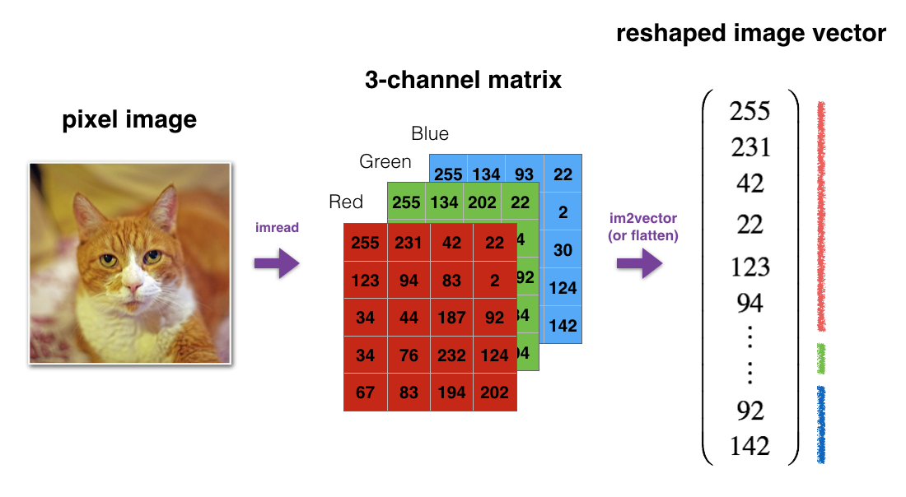
Image to vector

Slide 14
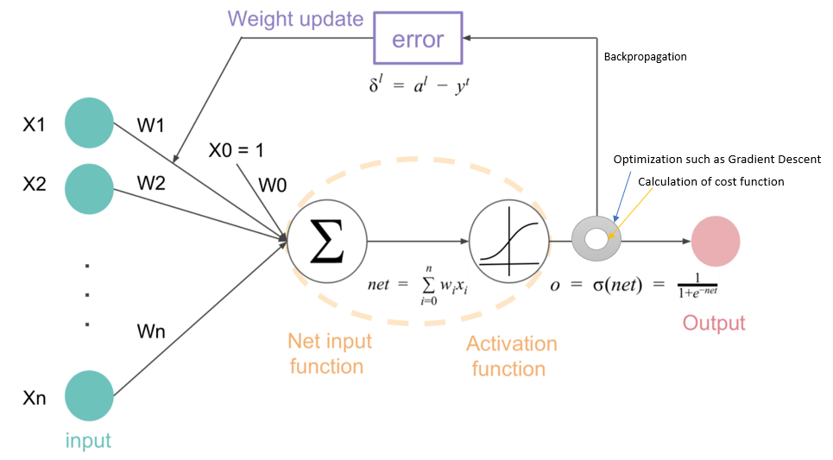
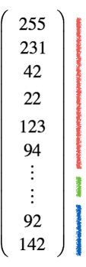

Slide 15
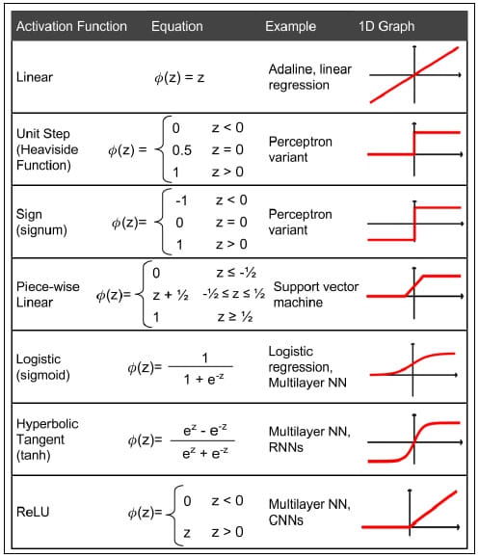
Activation Functions

Slide 16
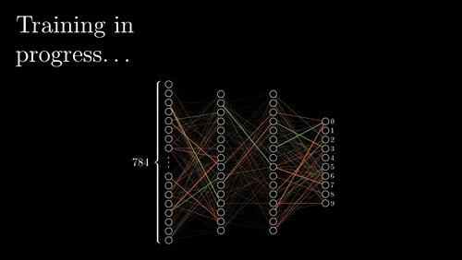
Activation Functions

Slide 17
So, what is Deep Learning?
The short answers
‘Deep Learning’ means using a neural network with many layers of nodes (there is no accurate numbers here) between input and output
The series of layers between input & output do feature identification and processing in a series of stages

Slide 18
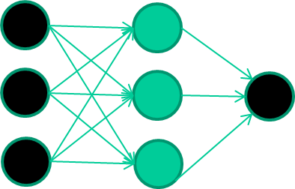
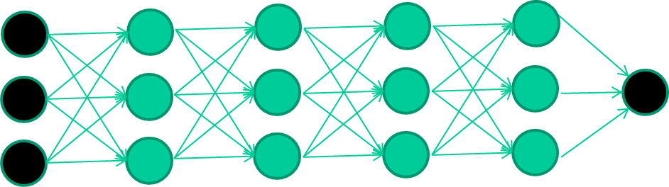
1 vs Deep
1-hidden layer
Deep-hidden layers
Again, we need to think of trade off balance between computation complexity and performance

Slide 19
Deep learning algorithms
There are many different deep learning algorithm designed for dealing with different problems. Some examples are:
Convolutional Neural Network (CNN)
Recurrent Neural Networks (RNNs)
Long Short-Term Memory Networks (LSTMs)
Stacked Auto-Encoders
Deep Boltzmann Machine (DBM)
Deep Belief Networks (DBN)

Slide 20
Computer Vision and Deep Learning

Slide 21

CNN: Convolutional Neural Network
Yann LeCun, Professor of Computer Science
The Courant Institute of Mathematical Sciences
New York University
Room 1220, 715 Broadway, New York, NY 10003, USA.
(212)998-3283 yann@cs.nyu.edu
In 1995, Yann LeCun and Yoshua Bengio introduced the concept of convolutional neural networks.
A path towards human-level intelligence
(01/04/2022)
https://www.youtube.com/watch?v=_K0h7oEe8BQ&list=PLZXqDfYHTYo4U_Q-LVK72xzRe2JhlwOzI&index=19

Slide 22
About CNN’s
CNN’s Were neurobiological motivated by the findings of locally sensitive and implicitly extracts relevant features.
Convolutional Neural Networks are a special kind of multi-layer neural networks with feed-forward network that can extract topological properties from an image.
Like almost every other neural networks they are trained with a version of the back-propagation algorithm.
Convolutional Neural Networks are designed to recognize visual patterns directly from pixel images with minimal preprocessing.
They can recognize patterns with extreme variability (such as handwritten characters).

Slide 23
Classification
f1
Classification
Convolutional neural network
f 2
Input
Pre-processing for feature extraction
f1 … fn
Classification
output
Input
Feature extraction
Shift and distortion invariance
classification
output

Slide 24
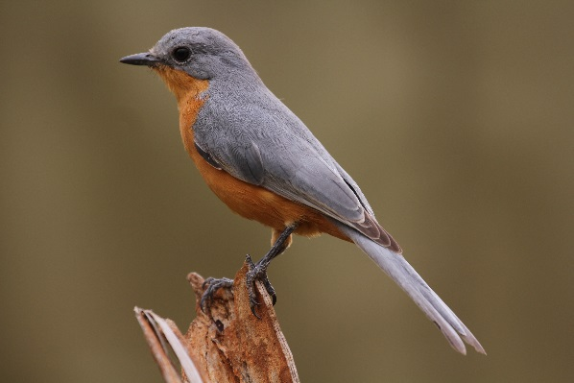
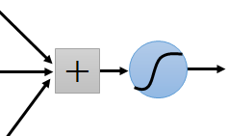
CNN by Example
Some patterns are much smaller than the whole image
Can represent a small region with fewer parameters
“beak” detector

Slide 25
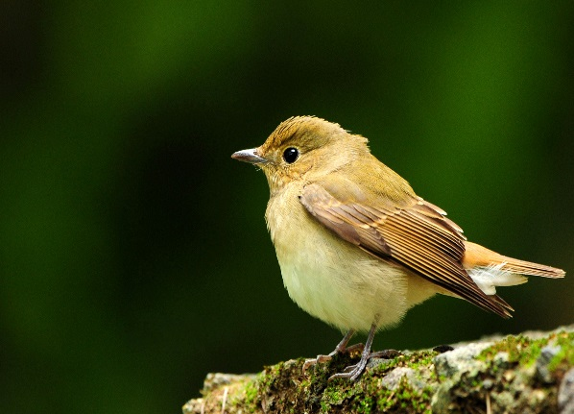
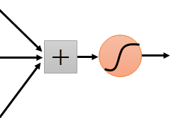
Same pattern appears in different places:
They can be compressed!
What about training a lot of such “small” detectors and each detector must “move around”.
“upper-left beak” detector
They can be compressed
to the same parameters.
“middle beak” detector

Slide 26
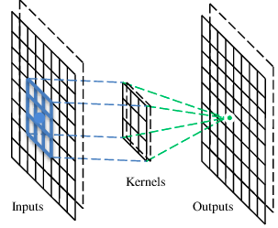
A convolutional layer
A CNN is a neural network with some convolutional layers
(and some other layers). A convolutional layer has a number
of filters that does convolutional operation.
Beak detector
A filter

Slide 27
Convolution
These are the network parameters to be learned.
1 | -1 | -1
-1 | 1 | -1
-1 | -1 | 1
1 | 0 | 0 | 0 | 0 | 1
0 | 1 | 0 | 0 | 1 | 0
0 | 0 | 1 | 1 | 0 | 0
1 | 0 | 0 | 0 | 1 | 0
0 | 1 | 0 | 0 | 1 | 0
0 | 0 | 1 | 0 | 1 | 0
Filter 1
-1 | 1 | -1
-1 | 1 | -1
-1 | 1 | -1
Filter 2
……
6 x 6 image
Each filter detects a small pattern (3 x 3).

Slide 28
Convolution
1 | -1 | -1
-1 | 1 | -1
-1 | -1 | 1
Filter 1
stride=1
1 | 0 | 0 | 0 | 0 | 1
0 | 1 | 0 | 0 | 1 | 0
0 | 0 | 1 | 1 | 0 | 0
1 | 0 | 0 | 0 | 1 | 0
0 | 1 | 0 | 0 | 1 | 0
0 | 0 | 1 | 0 | 1 | 0
Dot
product
3
-1
6 x 6 image

Slide 29
Convolution
1 | -1 | -1
-1 | 1 | -1
-1 | -1 | 1
Filter 1
If stride=2
1 | 0 | 0 | 0 | 0 | 1
0 | 1 | 0 | 0 | 1 | 0
0 | 0 | 1 | 1 | 0 | 0
1 | 0 | 0 | 0 | 1 | 0
0 | 1 | 0 | 0 | 1 | 0
0 | 0 | 1 | 0 | 1 | 0
3
-3
6 x 6 image

Slide 30
Convolution
1 | -1 | -1
-1 | 1 | -1
-1 | -1 | 1
Filter 1
stride=1
1 | 0 | 0 | 0 | 0 | 1
0 | 1 | 0 | 0 | 1 | 0
0 | 0 | 1 | 1 | 0 | 0
1 | 0 | 0 | 0 | 1 | 0
0 | 1 | 0 | 0 | 1 | 0
0 | 0 | 1 | 0 | 1 | 0
3
-1
-3
-1
-3
1
0
-3
-3
-3
0
1
3
-2
-2
-1
6 x 6 image

Slide 31
Convolution
-1 | 1 | -1
-1 | 1 | -1
-1 | 1 | -1
Filter 2
stride=1
Repeat this for each filter
1 | 0 | 0 | 0 | 0 | 1
0 | 1 | 0 | 0 | 1 | 0
0 | 0 | 1 | 1 | 0 | 0
1 | 0 | 0 | 0 | 1 | 0
0 | 1 | 0 | 0 | 1 | 0
0 | 0 | 1 | 0 | 1 | 0
3
-1
-3
-1
-1
-1
-1
-1
-3
1
0
-3
-1
-1
-2
1
Feature
Map
-3
-3
0
1
-1
-1
-2
1
3
-2
-2
-1
6 x 6 image
-1
0
-4
3
Two 4 x 4 images
Forming 2 x 4 x 4 matrix

Slide 32
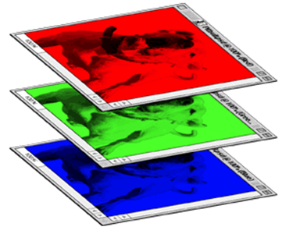
Color image: RGB 3 channels
1 | -1 | -1
-1 | 1 | -1
-1 | -1 | 1
-1 | 1 | -1
-1 | 1 | -1
-1 | 1 | -1
1 | -1 | -1
-1 | 1 | -1
-1 | -1 | 1
-1 | 1 | -1
-1 | 1 | -1
-1 | 1 | -1
1 | -1 | -1
-1 | 1 | -1
-1 | -1 | 1
-1 | 1 | -1
-1 | 1 | -1
-1 | 1 | -1
Filter 1
Filter 2
Color image
1 | 0 | 0 | 0 | 0 | 1
0 | 1 | 0 | 0 | 1 | 0
0 | 0 | 1 | 1 | 0 | 0
1 | 0 | 0 | 0 | 1 | 0
0 | 1 | 0 | 0 | 1 | 0
0 | 0 | 1 | 0 | 1 | 0
1 | 0 | 0 | 0 | 0 | 1
0 | 1 | 0 | 0 | 1 | 0
0 | 0 | 1 | 1 | 0 | 0
1 | 0 | 0 | 0 | 1 | 0
0 | 1 | 0 | 0 | 1 | 0
0 | 0 | 1 | 0 | 1 | 0
1 | 0 | 0 | 0 | 0 | 1
0 | 1 | 0 | 0 | 1 | 0
0 | 0 | 1 | 1 | 0 | 0
1 | 0 | 0 | 0 | 1 | 0
0 | 1 | 0 | 0 | 1 | 0
0 | 0 | 1 | 0 | 1 | 0

Slide 33
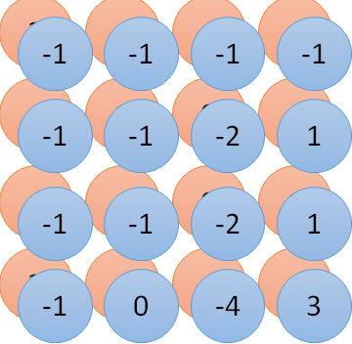
Convolution v.s. Fully Connected
1 | 0 | 0 | 0 | 0 | 1
0 | 1 | 0 | 0 | 1 | 0
0 | 0 | 1 | 1 | 0 | 0
1 | 0 | 0 | 0 | 1 | 0
0 | 1 | 0 | 0 | 1 | 0
0 | 0 | 1 | 0 | 1 | 0
1 | -1 | -1
-1 | 1 | -1
-1 | -1 | 1
-1 | 1 | -1
-1 | 1 | -1
-1 | 1 | -1
convolution
image
1 | 0 | 0 | 0 | 0 | 1
0 | 1 | 0 | 0 | 1 | 0
0 | 0 | 1 | 1 | 0 | 0
1 | 0 | 0 | 0 | 1 | 0
0 | 1 | 0 | 0 | 1 | 0
0 | 0 | 1 | 0 | 1 | 0
Fully-connected
……
……

Slide 34
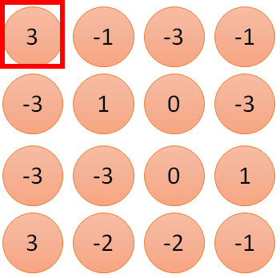
1 | -1 | -1
-1 | 1 | -1
-1 | -1 | 1
1
1
Filter 1
2
0
3
0
3
4:
0
1 | 0 | 0 | 0 | 0 | 1
0 | 1 | 0 | 0 | 1 | 0
0 | 0 | 1 | 1 | 0 | 0
1 | 0 | 0 | 0 | 1 | 0
0 | 1 | 0 | 0 | 1 | 0
0 | 0 | 1 | 0 | 1 | 0
…
0
8
1
9
0
10:
0
…
13
0
6 x 6 image
14
0
fewer parameters!
15
Only connect to 9 inputs, not fully connected
1
16
1
…

Slide 35
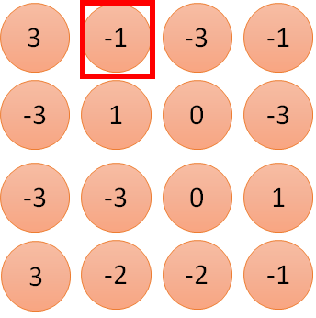
1 | -1 | -1
-1 | 1 | -1
-1 | -1 | 1
1:
1
Filter 1
2:
0
3:
0
3
4:
0
1 | 0 | 0 | 0 | 0 | 1
0 | 1 | 0 | 0 | 1 | 0
0 | 0 | 1 | 1 | 0 | 0
1 | 0 | 0 | 0 | 1 | 0
0 | 1 | 0 | 0 | 1 | 0
0 | 0 | 1 | 0 | 1 | 0
…
7:
0
8:
1
-1
9:
0
10:
0
…
13:
0
6 x 6 image
14:
0
Fewer parameters
15:
1
16:
1
Shared weights
Even fewer parameters
…

Slide 36
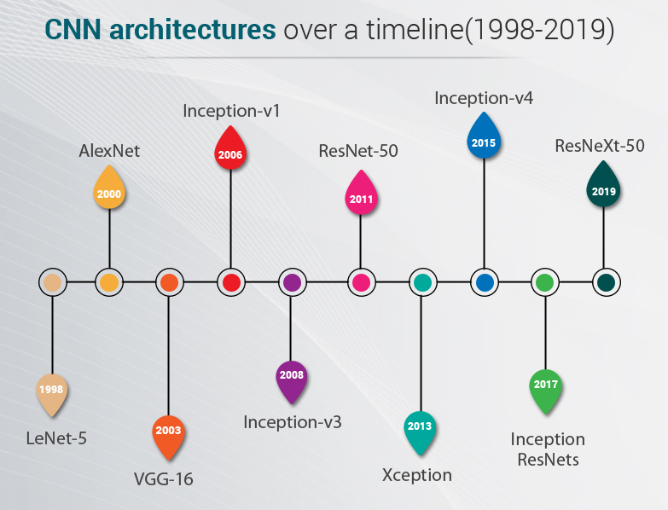
Different CNN Architectures

Slide 37
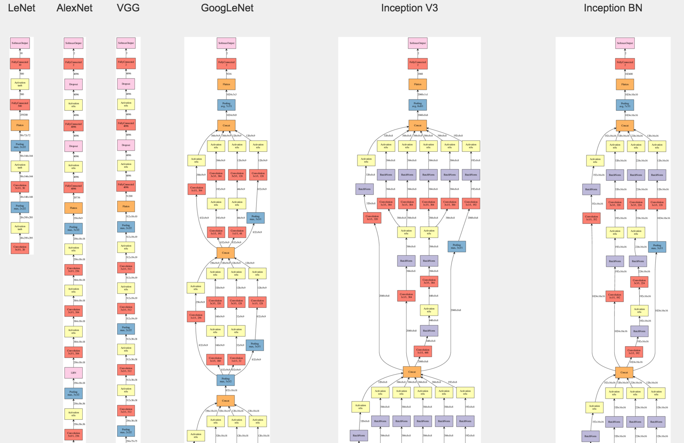
Differences in examples

Slide 38
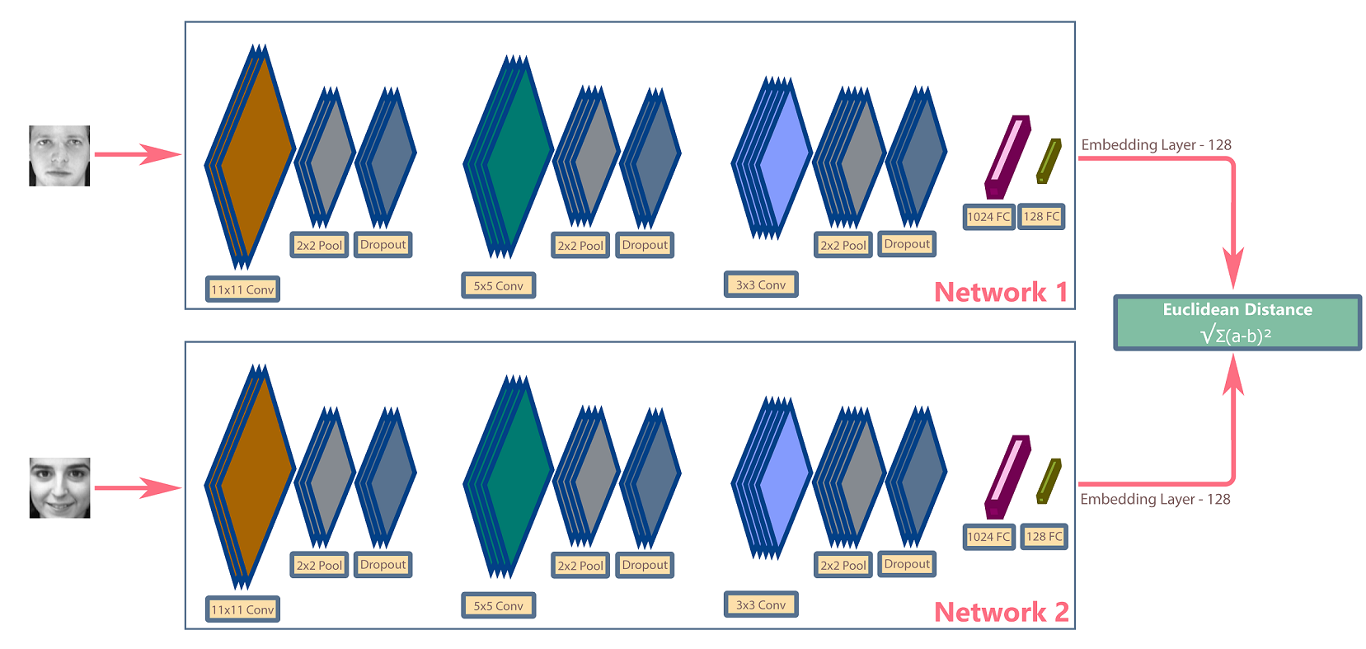
Contrastive Deep Learning (few short) algorithms

Slide 39
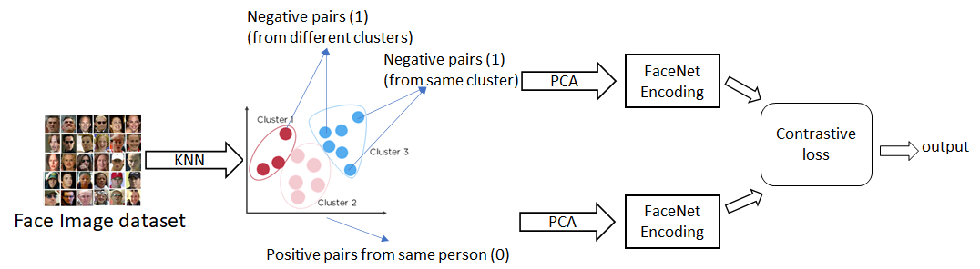
One possible improvement which I am working on

Slide 40
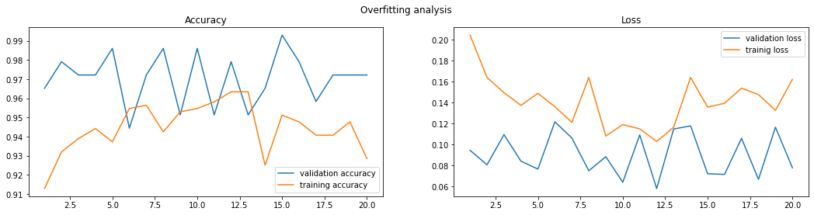
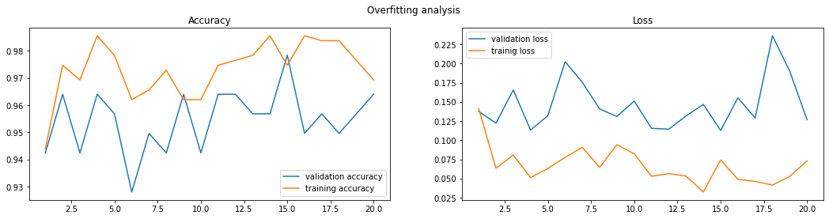
https://www.kaggle.com/code/harryyu/cluster-siamese-model-on-face-recognition-1-data

Slide 41
Other types of DNN
We will talk about them in next time lab session

Slide 42
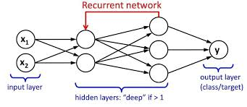
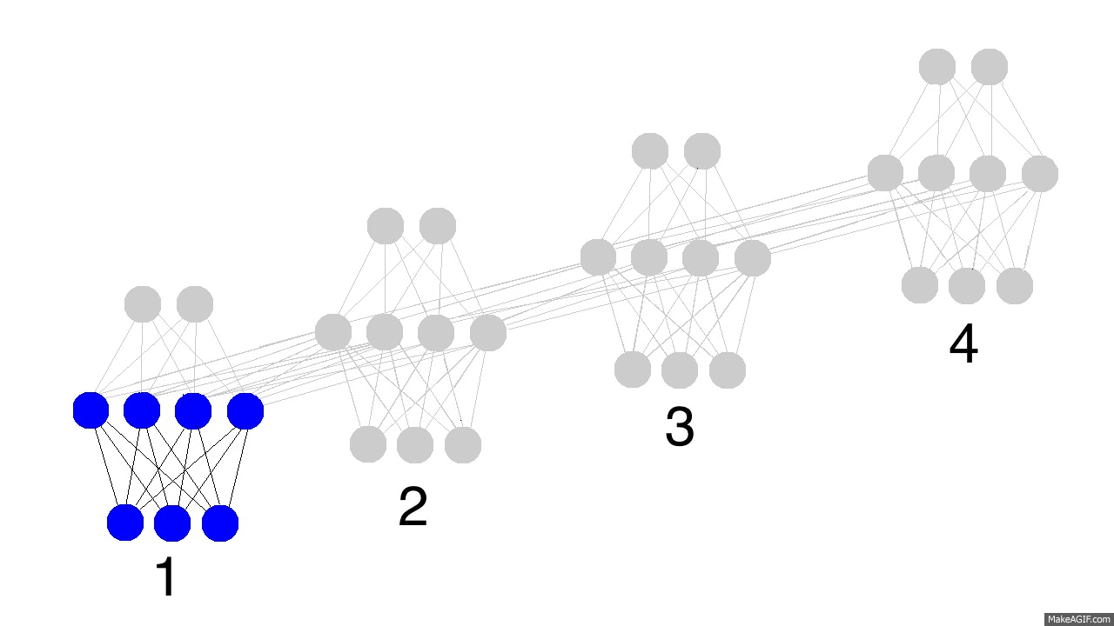
Recurrent Neural Networks
Recurrent networks, take as their input not just the current input example they see, but also what they have perceived previously in time.

Slide 43
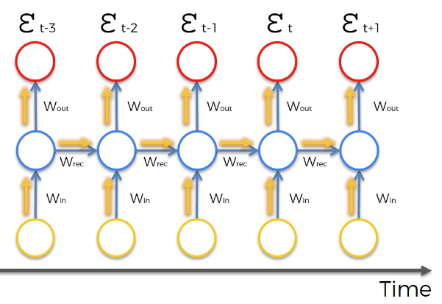
The Problem of Long-Term Dependencies
Ex. 1: I used to live in France.
I learnt to speak ?.
Ex. 2: I grew up in France … (a long sentence)
I speak fluent ?.
RNN is good
RNN theoretically should be good, but not in practices
Vanishing gradient problem
Notes:
consider a language model trying to predict the next word based on the previous ones. If we are trying to predict the last word in “the clouds are in the sky,” we don’t need any further context – it’s pretty obvious the next word is going to be sky. In such cases, where the gap between the relevant information and the place that it’s needed is small, RNNs can learn to use the past information.

Slide 44
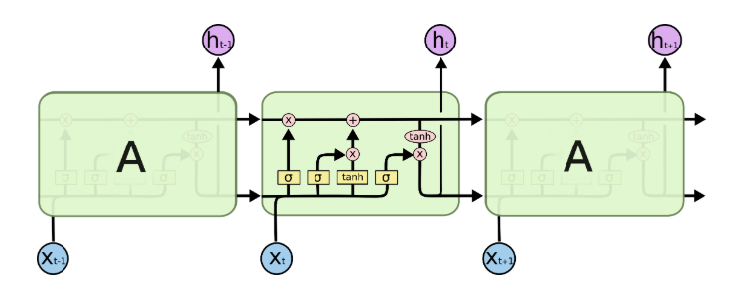
LSTM (Long Short Term Memory networks)
LSTM is a special kind of recurrent neural network capable of learning long-term dependencies.
They were introduced by Hochreiter & Schmidhuber in 1997.

Slide 45
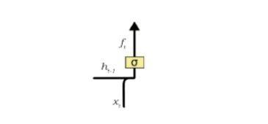
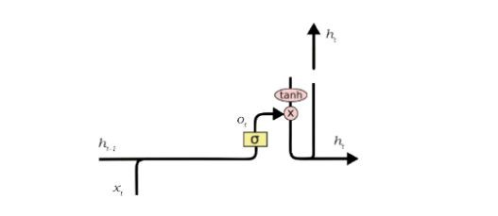
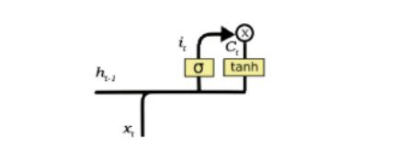
How does LSTM work?
Forget gate
Input gate
Output gate
Notes:
Forget Gate
There are some information from the previous cell state that is not needed for the present unit in a LSTM. A forget gate is responsible for removing this information from the cell state.
Input Gate
The process of adding new information takes place in input gate. Here combination of x t and h t-1 is passed through sigmoid and tanh functions(activation functions) and added. Creating a vector containing all the possible values that can be added (as perceived from h t-1 and x t) to the cell state. This is done using the tanh function. By this step we ensure that only that information is added to the cell state that is important and is not redundant.
Output Gate
A vector is created after applying tanh function to the cell state.Then making a filter using the values of h t-1 and x t, such that it can regulate the values that need to be output from the vector created above. This filter again employs a sigmoid function.Then both of them are multiplied to form output of that cell state.

Slide 46
Pre-trained models
Pre-trained learning models are good sources for solving a common AI problem. Due to time restrictions or computational restraints, it’s not always possible to build a model from scratch which is why pre-trained models are useful. In addition, you can use a pre-trained model as a benchmark to either improve the existing model or test your own model against it.
Pre-trained CV models e.g YOLO (Object recognision), CIFAR10 (image classification based on ImageNet)
Pre-trained NLP models e.g. BERT, GPT-3…

Slide 47
Transfer learning process
From a practical perspective, the entire transfer learning process can be summarised as follows:
Select a pre-trained model based on your task
Classify your problem according to the Size-Similarity Matrix
Fine-tune your model

Slide 48
Generative Adversarial Networks (GANs)
Generative Adversarial Networks, or GANs for short, are an approach to generative modelling using deep learning methods, such as convolutional neural networks.
Generative modelling is an unsupervised learning task in machine learning that involves automatically discovering and learning the regularities or patterns in input data in such a way that the model can be used to generate or output new examples that plausibly could have been drawn from the original dataset.
Jason Brownlee
A Gentle Introduction to Generative Adversarial Networks (GANs)
https://machinelearningmastery.com/what-are-generative-adversarial-networks-gans/

Slide 49
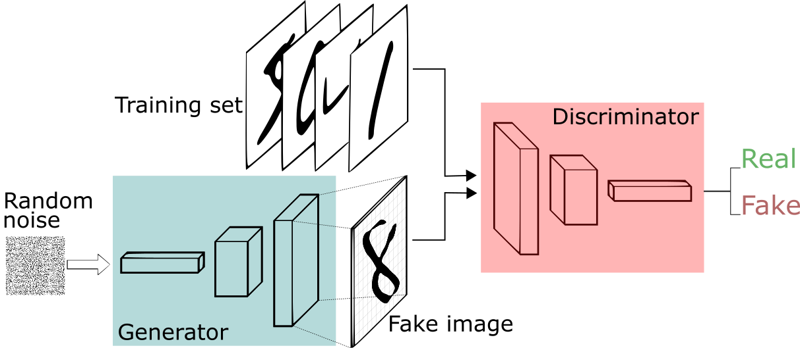
GANs Process/Architecture

Slide 50
Explainable AI
The current generation of AI systems offer tremendous benefits, but their effectiveness will be limited by the machine’s inability to explain its decisions and actions to users.
Explainable AI will be essential if users are to understand, appropriately trust, and effectively manage this incoming generation of artificially intelligent partners.

Slide 51
Explainability of Today’s Algorithms
Learning Techniques (today)
Explainability
(notional)
Neural Nets
Graphical
Models
Deep
Learning
Ensemble
Methods
Bayesian
Belief Nets
Prediction Accuracy
SRL
Random
Forests
AOGs
CRFs
HBNs
Statistical
Models
MLNs
Decision
Trees
Markov Models
SVMs
Explainability

Slide 52
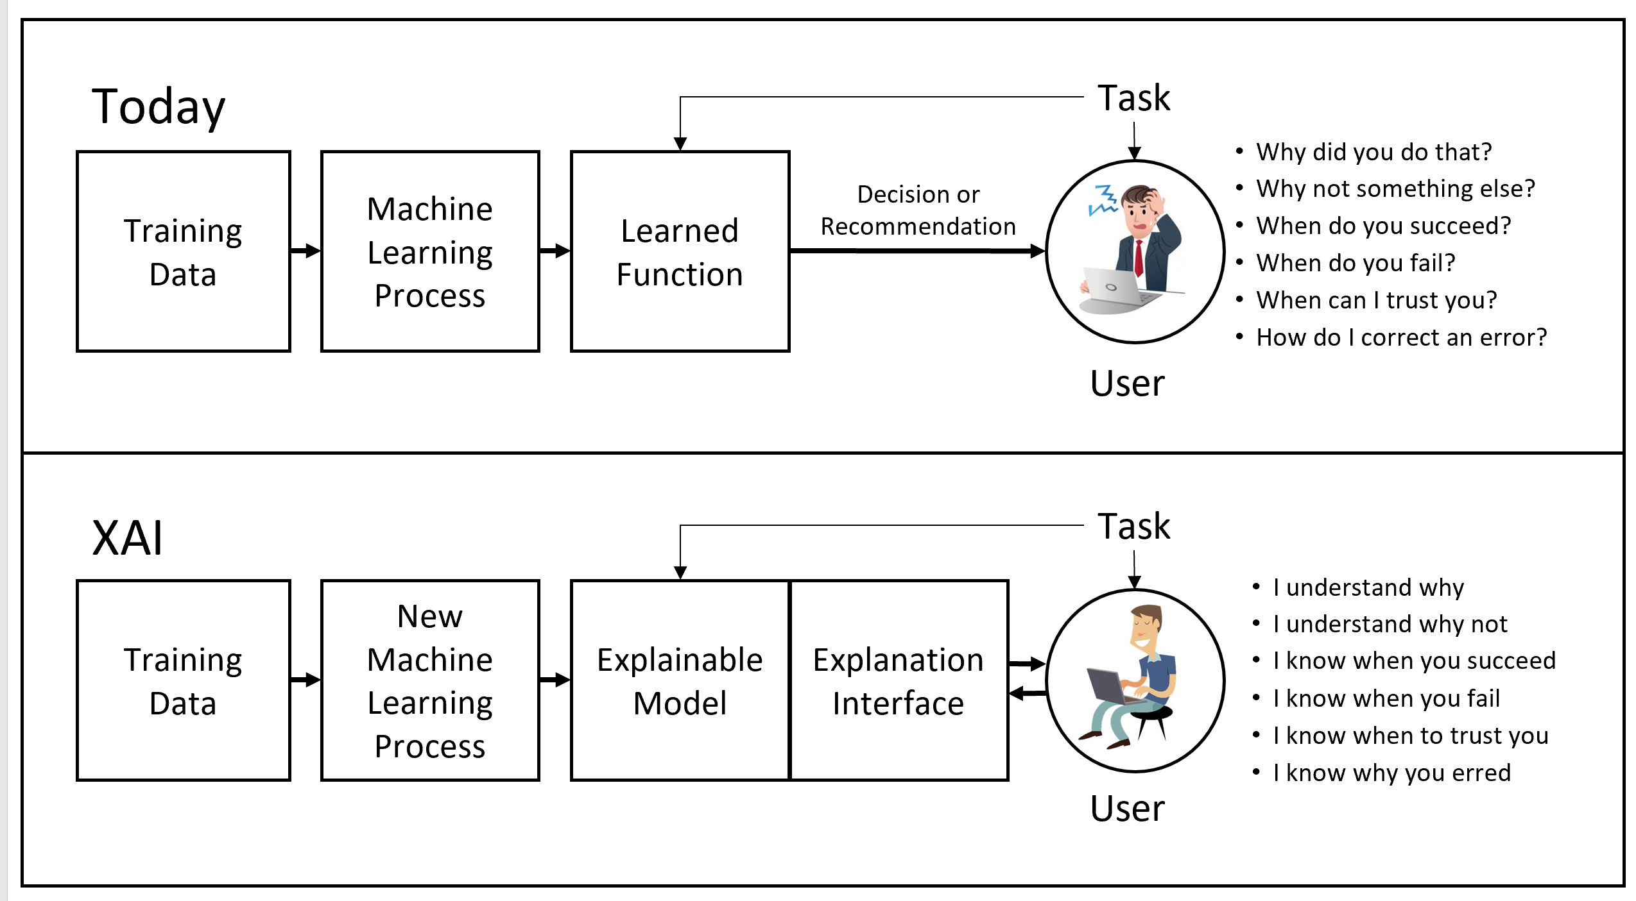
XAI vs AI

Slide 53
Python XAI libraries
Here are 6 popular Python frameworks for model interpretability and explainability
SHAP
LIME
Shapash
ELI5
InterpretML
OmniXAI (Integrated framework of libraries above)

Slide 54
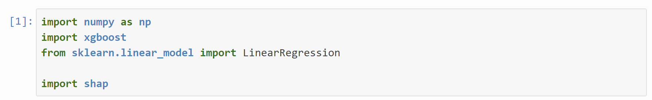
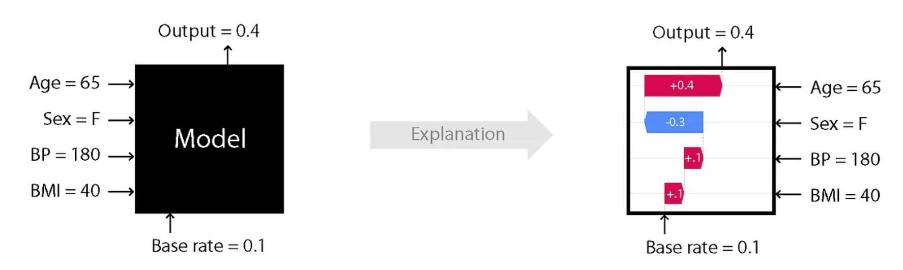
SHAP example

Slide 55
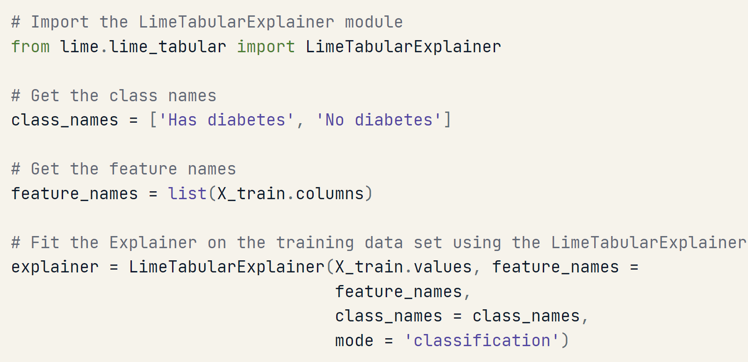
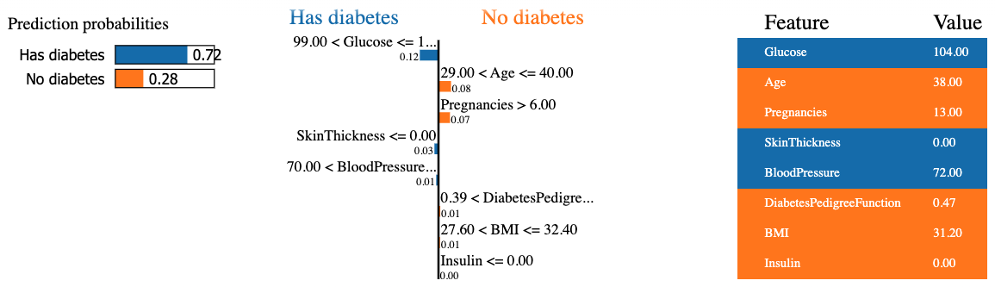
LIME

Slide 56
Summary
In this lecture:
We have learnt ANN, Deep Learning (DL) and different types of DL.
We focused on two research areas of Computer Vision (CV) and NLP.
Particularly, we had a detail study on CNN and LSTM (a special case of RNN)
Ideas of transfer learning and GANs
Next:
NLP (Natural Language Processing) and practices

